Slide 1
Hopping Robot Update VII
Experimental Setup

Slide 2
Current Objective
Validate/improve simulation with experiments
Design experimental setup to capture:
Forces (load cell)
Jump height (cameras)
Power consumption (V/I sensor)

Slide 3
Literature
A bio-inspired jumping robot: Modeling, simulation, design, and experimental results

Slide 4
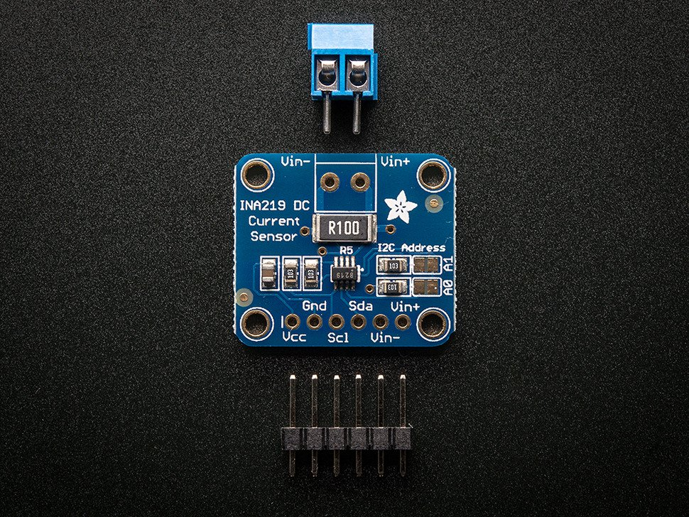
Voltage Current Sensor
INA219 High Side DC Current Sensor Breakout - 26V ±3.2A Max

Slide 5
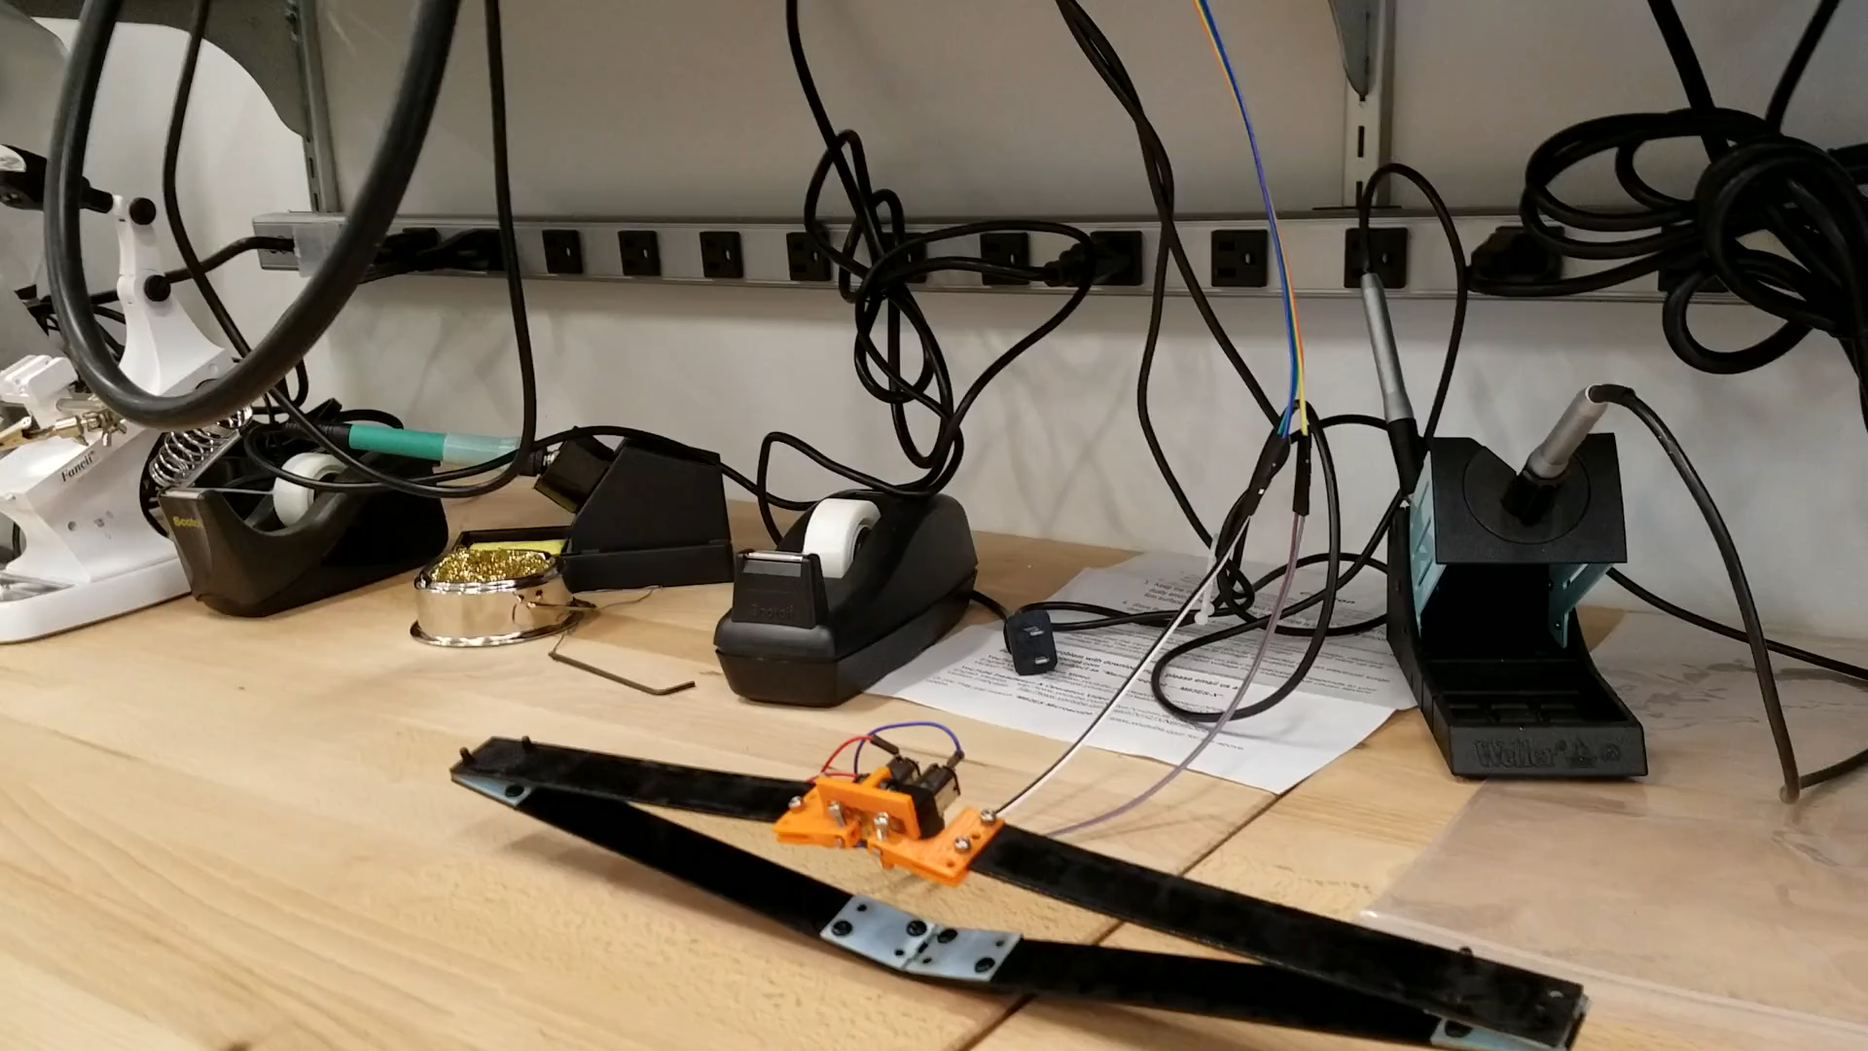
Jumping

Slide 6
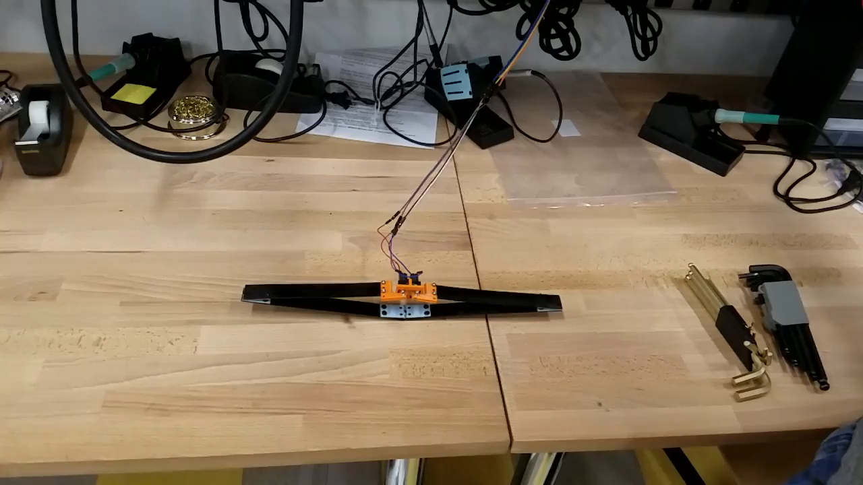
Jumping

Slide 7
Observations Compared to Simulation
Not very high
Deflection of fiberglass leg segments
Does not leave ground until almost fully extended (as apposed to at ~45 deg)
Unity closer to that with increased mass
Weighed robot: 0.0714 kg – much heavier (vs. 0.0265kg ~3x)
 | MATLAB | Unity
Original | 1.05m | .631m
Heavier | 0.198m | 0.0404m

Slide 8
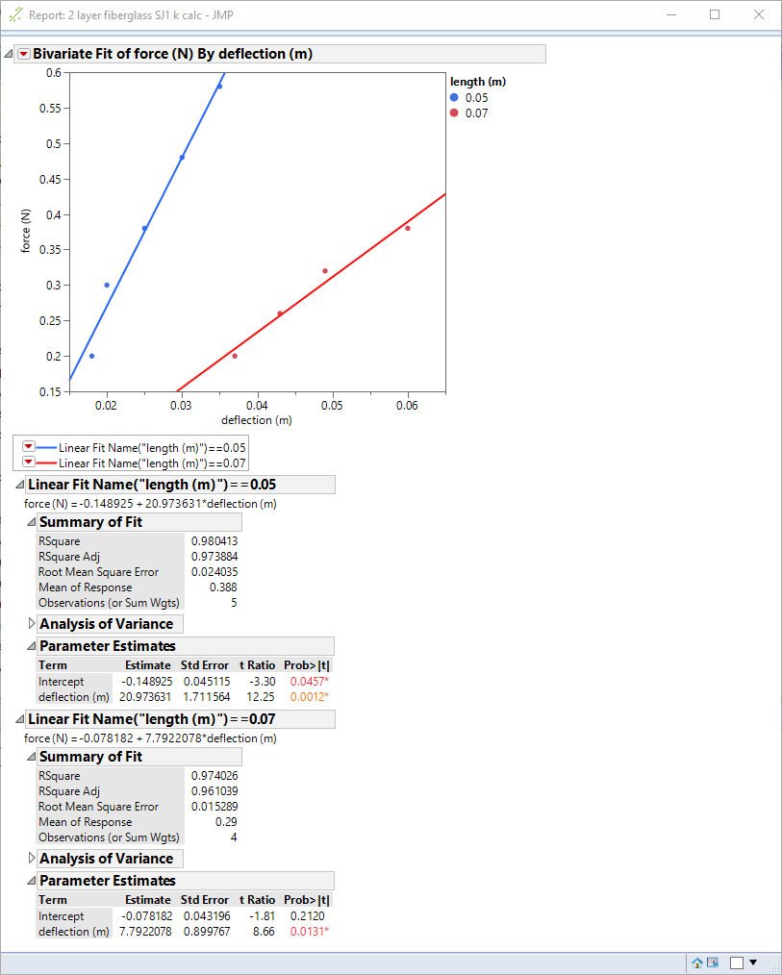
Add Deflection to model
Simulate nonrigidity—spring joint in leg members
Cube relationship: k1*L1³≈k2*L2³ ?
δ_{B} = F L³ / (3 E I)

Slide 9
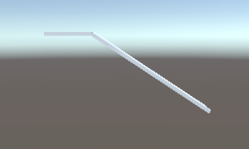
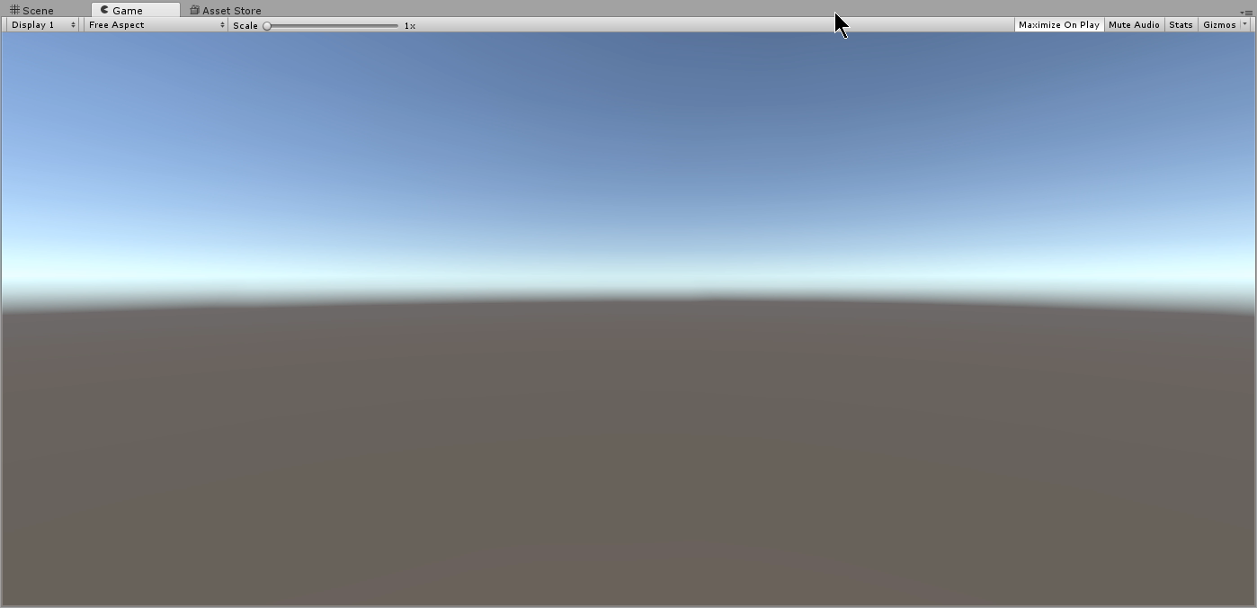
Add Deflection to Unity
2.9cm for .5N

Slide 10
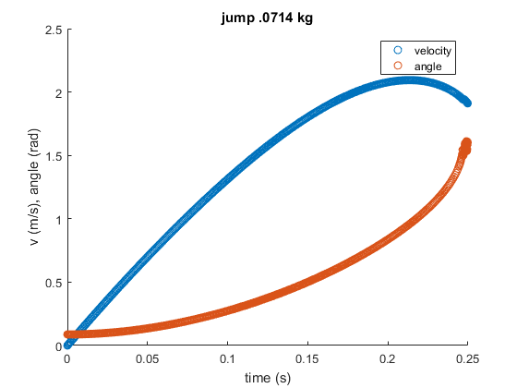
Load Cell Scaling
FT300 max torque +/-30Nm, Noise .02 Nm (.08 Nm)
Robot weight .700 N
Approx. max force from velocity in MATLAB: 1.03N
Amplify with moment arm
Estimated moment of wood (76 cm): 1.14 Nm

Slide 11
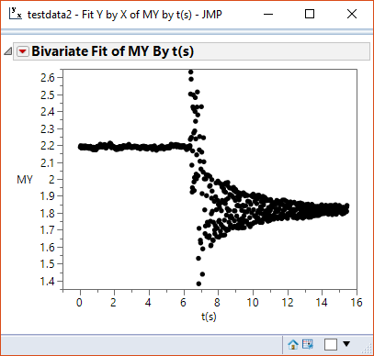
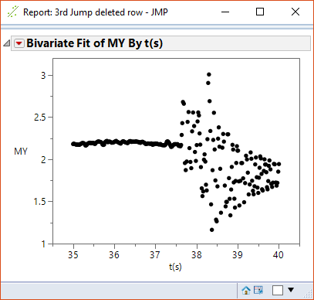
Load Cell Testing

Slide 12
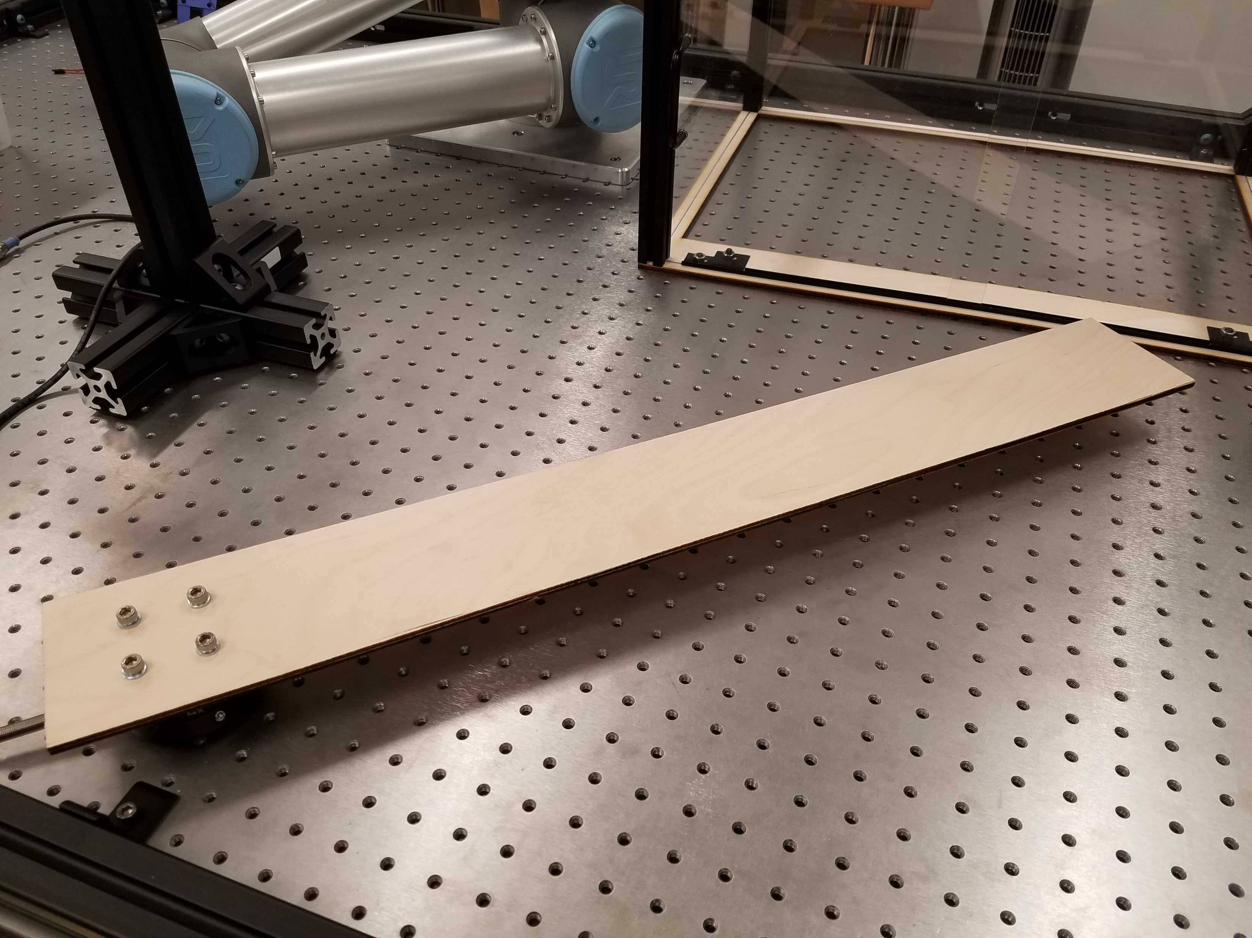
Load Cell Testing

Slide 13
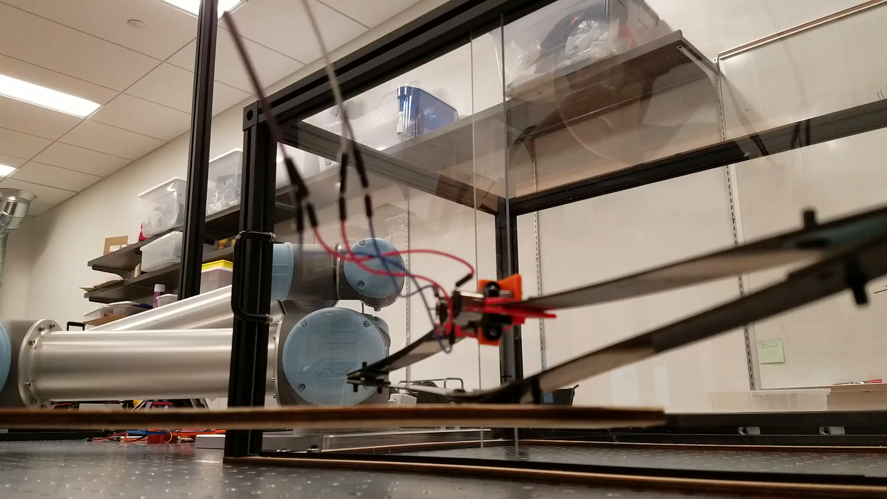
Load Cell Testing

